Slide 1
DATA ANALYSIS FOR FUTURE TRANSPORTATION SYSTEMS PROJECT- BLIND ASSIGNMENT 1
Arindam Sharma – 11128421
Riddhima Srivastava - 11128422

Slide 2

Contents
INTRODUCTION
TASK 1 and TASK 2 – Max Speed and Braking
TASK 3 – Steering Correction Analysis
TASK 4 – Lateral Acceleration
TASK 5 – Gyro data correlation with Pitch and Roll
TASK 6 – Spatial Lag Identification
Conclusions
Politecnico di Milano | 1863 Arindam Sharma, Riddhima Srivastava

Slide 3

Introduction
01

Slide 4
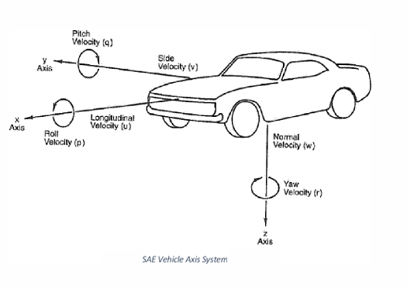
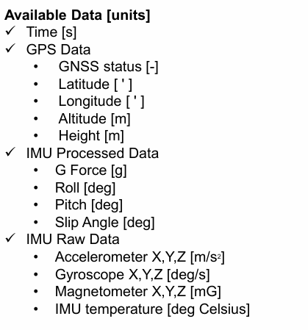
Strain History
DAFTS PROJECT
4
INTRODUCTION
In the following assignment, we are provided with IMU and GPS for four datasets and we are tasked with performing 6 different tasks using this data.
For the first 5 tasks, we have performed single analysis on the datasets while splitting the workload.
The available data is as follows-
Politecnico di Milano | 1863 Arindam Sharma, Riddhima Srivastava

Slide 5
Task 1 and Task 2 Max Speed and Braking
02

Slide 6
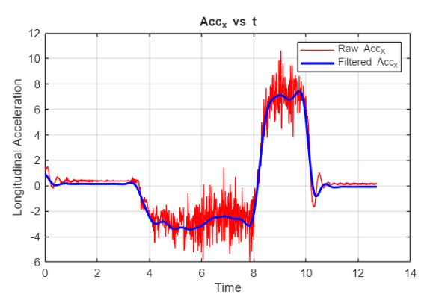
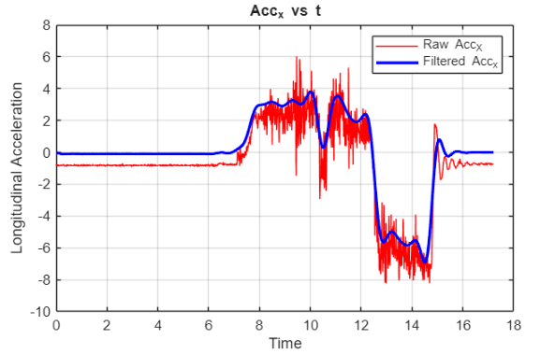
DAFTS PROJECT
6
IMU AND GPS DATA
We have been provided with IMU and GPS data. To carry out this task the data which will be utilised include-
Accelerometer X (Longitudinal Acceleration)
Latitude
Longitude
Time
To ensure physically consistent velocity reconstruction, the IMU acceleration signal was detrended to eliminate bias and low-frequency drift, low-pass filtered for noise reduction, and subsequently integrated without post-processing of the velocity.
We analyzed the Acceleration X data and inferred that the orientation of IMU for dataset 1 is inverted with respect to the SAE orientation as seen in the top figure. Thus, a condition to invert it has been implemented to correct orientation.
Fig. Acc X for dataset 1
Fig. Corrected Acc X for dataset 1
Politecnico di Milano | 1863 Arindam Sharma, Riddhima Srivastava

Slide 7
DAFTS PROJECT
7
IMU AND GPS DATA
Table : Common Problems in Raw data
Data Source | Problem in Raw Data | Solution Applied
GPS (Latitude–Longitude) | High-frequency jitter | Low-pass Butterworth filtering of position data
GPS (Speed) | Sudden spikes | Median filtering and MAD-based spike rejection
IMU (Acceleration) | DC offset / bias | Mean removal (detrending) before integration
IMU (Acceleration) | High-frequency noise | Low-pass Butterworth filtering
Politecnico di Milano | 1863 Arindam Sharma, Riddhima Srivastava

Slide 8
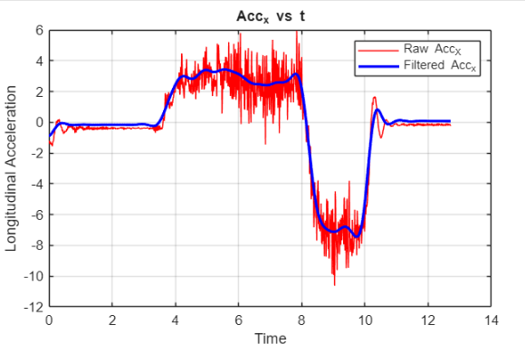
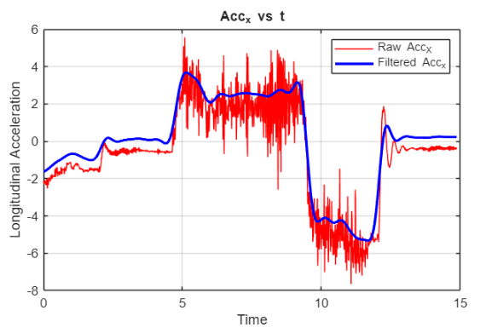
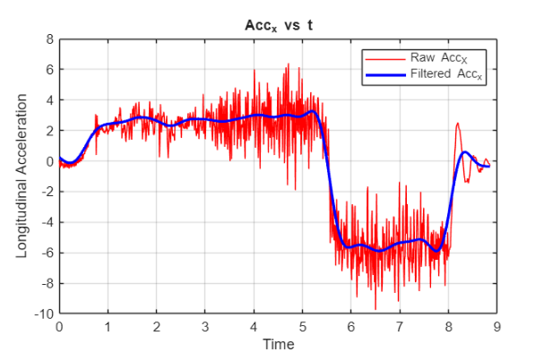
DAFTS PROJECT
8
Corrected Longitudinal Acceleration vs Time
Fig. Data 1
Fig. Data 2
Fig. Data 3
Fig. Data 4
Politecnico di Milano | 1863 Arindam Sharma, Riddhima Srivastava

Slide 9
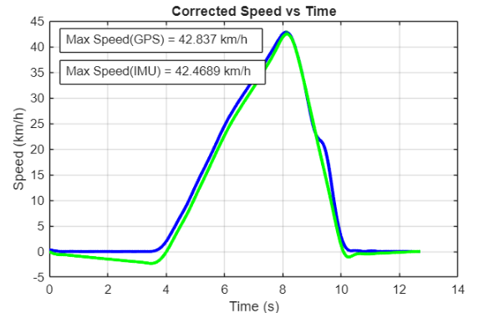
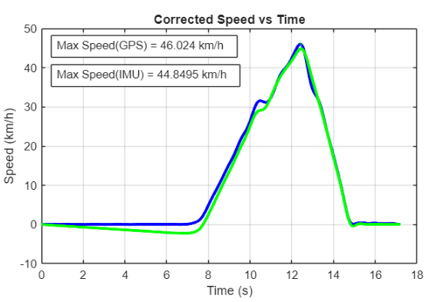
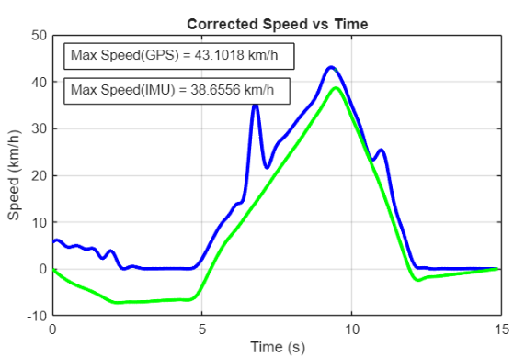
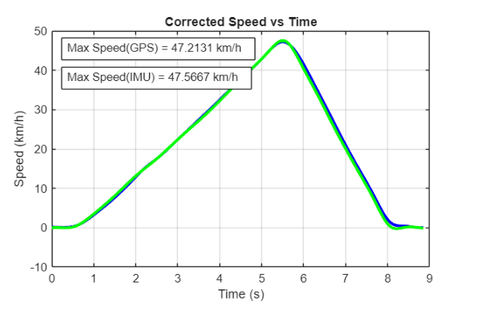
DAFTS PROJECT
9
Speed Profile
We have used both IMU and GPS data to generate a speed profile and determine the location of max speed.
Integrating the filtered Acc_x data and using Haversine’s Distance formula for GPS provides us with the two plots.
The blue lines depict the GPS data whereas the green lines depict the IMU data.
Fig. Data 1
Fig. Data 2
Fig. Data 3
Fig. Data 4
Politecnico di Milano | 1863 Arindam Sharma, Riddhima Srivastava

Slide 10
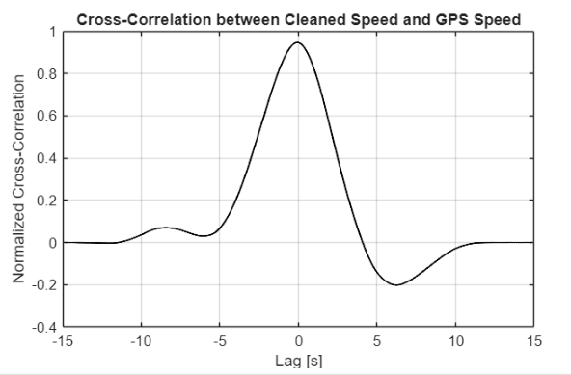
DAFTS PROJECT
10
Corrected Longitudinal Acceleration vs Time
An interesting identification made by us is in the comparison of the speed of dataset 3 from IMU and GPS data.
For the initial time period we can notice a large negative acceleration (around -2.2m/s2) even after detrending the data. This is more apparent in the speed profiles generated from IMU and GPS.
This led us to believe that there was a major orientation error in the IMU.
By considering the difference in the raw and filtered acceleration, we calculated the offset angle of the IMU to be around 73°.
By multiply the acceleration for the time period of T<3s for dataset 3, we were able to remedy this offset.
Fig. Offset in Speed Profiles for Data 3
Fig. Acc x for Data 3
Fig. Cross-correlation between the two speed profiles
Politecnico di Milano | 1863 Arindam Sharma, Riddhima Srivastava

Slide 11
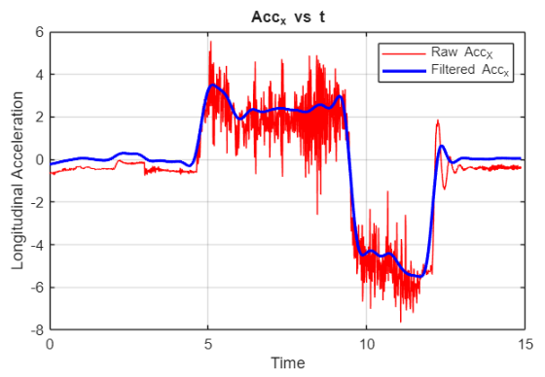
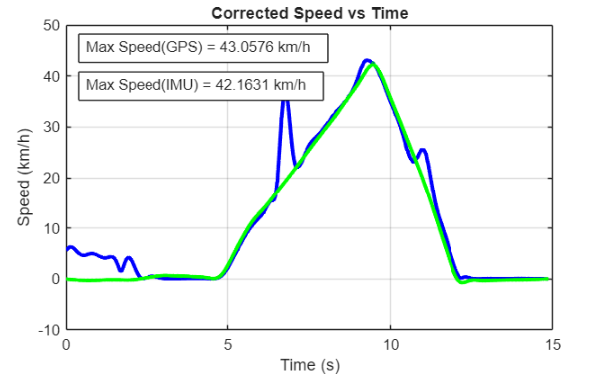
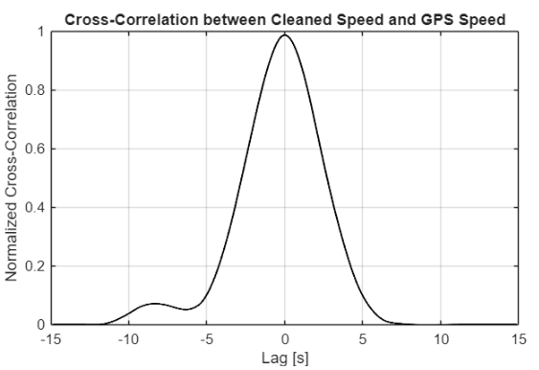
DAFTS PROJECT
11
Corrected Longitudinal Acceleration vs Time
Fig. Corrected Plots for Data 3
After multiplying the data with the calculated angle, we get a much accurate horizontal component for this acceleration. This can be seen with the corrected speed plot and a much more accurate correlation
Politecnico di Milano | 1863 Arindam Sharma, Riddhima Srivastava

Slide 12
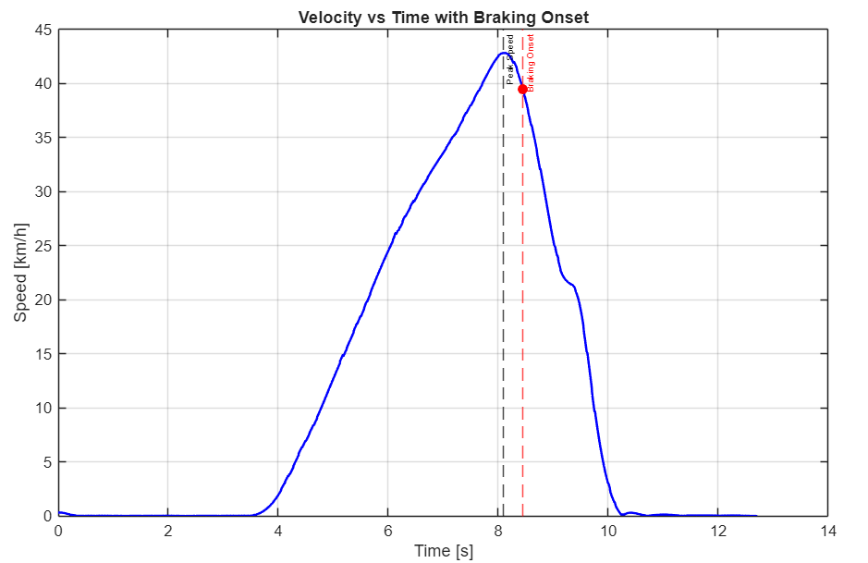
DAFTS PROJECT
12
BRAKING DETECTION
We have everything we require i.e. filtered longitudinal acceleration and speed profiles.
We have used GPS speed for braking detection as we believe that is more accurate and the final case is dependent on max speed which is nearly identical for both profiles.
Three conditions that we have imposed to detect braking are-
Acceleration below a threshold (-0.3m/s2)
Velocity gradient negative and below a threshold ( -0.2 m/s2)
Minimum time duration of 0.3s to detect sustained braking
Fig. Braking Detection
Politecnico di Milano | 1863 Arindam Sharma, Riddhima Srivastava

Slide 13
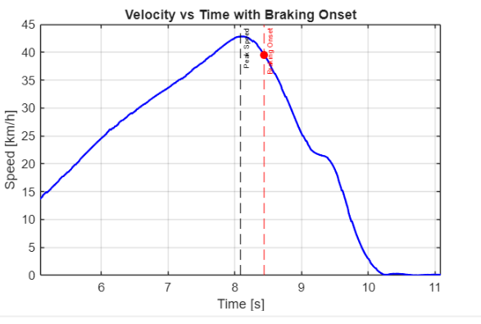
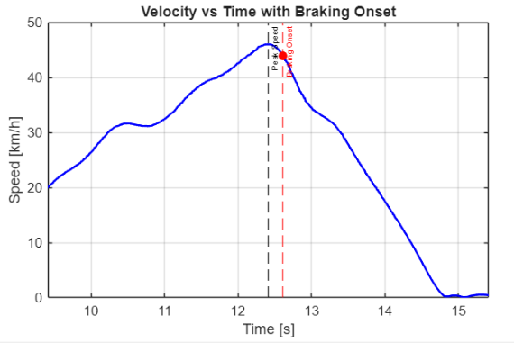
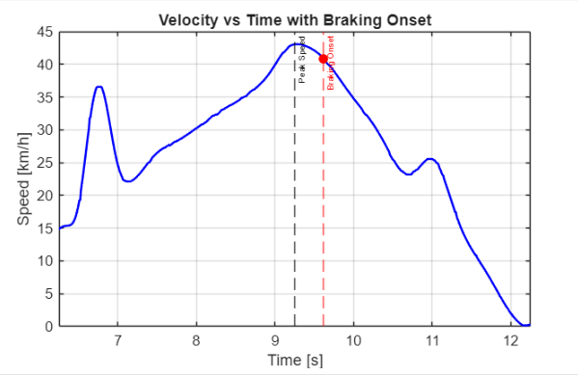
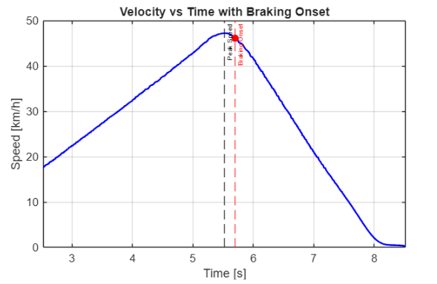
DAFTS PROJECT
13
BRAKING DETECTION
Fig. Data 1
Fig. Data 2
Fig. Data 3
Fig. Data 4
Politecnico di Milano | 1863 Arindam Sharma, Riddhima Srivastava

Slide 14
Task 3 Steering Correction Analysis
03

Slide 15
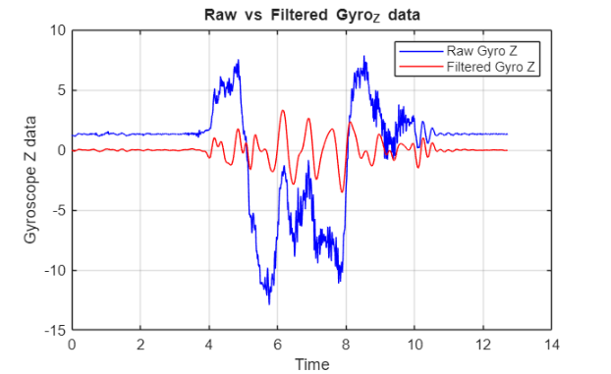
DAFTS PROJECT
15
STEERING CORRECTION ANALYSIS
The main task is to determine the major steering corrections made by the driver. The major dataset that is to be used is the Gyroscope Z data which gives us information about the rotation.
We begin by filtering the data with a band-pass Butterworth filter in a frequency range of 1-4 Hz.
The lower cut-off ensures that we do not consider normal driver movements.
The higher cut-off filters out the sensor noise and other high frequency components.
The filtered data should contain the main content for us to analyse the major steering actions.
Fig. Raw vs Filtered Gyro Data
Politecnico di Milano | 1863 Arindam Sharma, Riddhima Srivastava

Slide 16
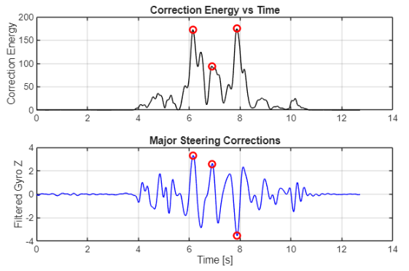
DAFTS PROJECT
16
STEERING CORRECTION ANALYSIS
We have considered the corrected gyro data and on first glance, the peaks should correlate to steering corrections.
However, the filtered yaw rate is still susceptible to some oscillations and noise bursts.
Thus, we have considered a second-order correction energy.
The correction energy suppresses the short spikes
It magnifies sustained effort
These 2 factors provide us with the main corrections from the filtered data.
Fig. Identification of correction points from steering energy
Politecnico di Milano | 1863 Arindam Sharma, Riddhima Srivastava

Slide 17
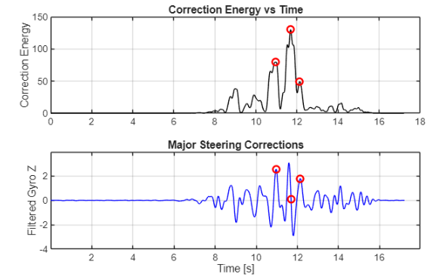
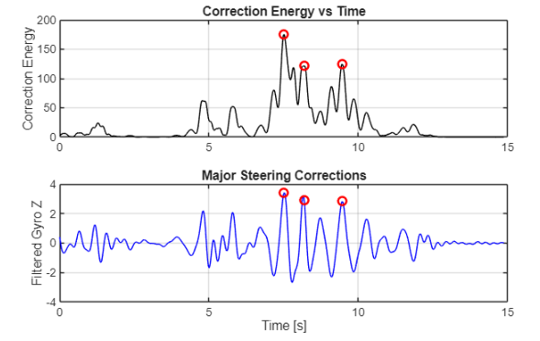
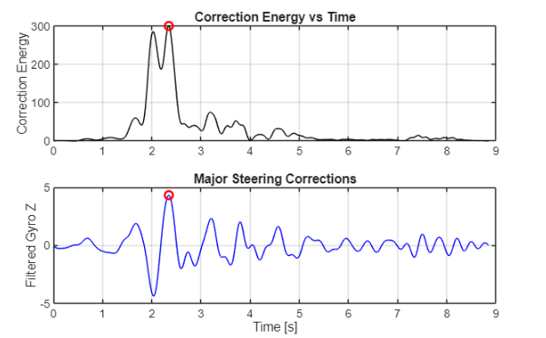
DAFTS PROJECT
17
STEERING CORRECTION ANALYSIS
Fig. Data 1
Fig. Data 2
Fig. Data 3
Fig. Data 4
Politecnico di Milano | 1863 Arindam Sharma, Riddhima Srivastava

Slide 18
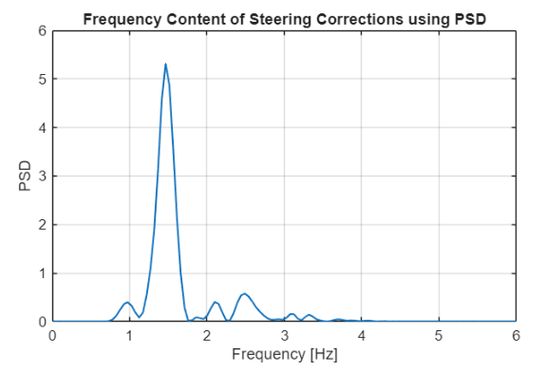
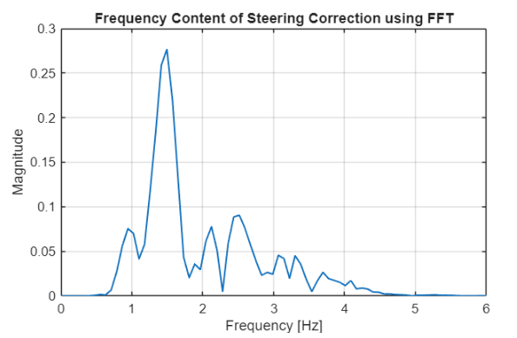
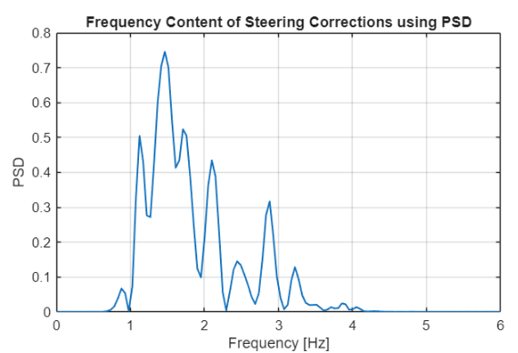
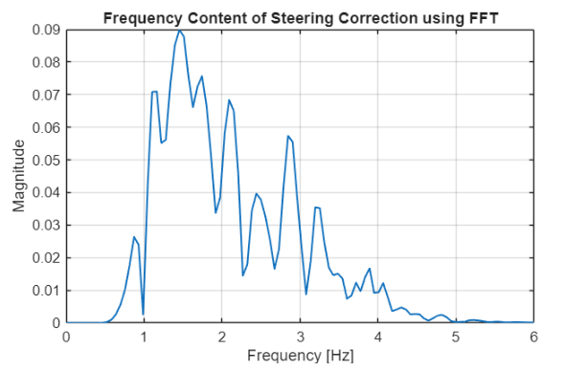
DAFTS PROJECT
18
FREQUENCY CONTENT
We have used Power Spectral Density using Welch’s method and a single FFT on the gyro data.
Both FFT and PSD identify the same dominant frequency content, confirming consistency of the signal.
The FFT highlights individual frequency components, whereas the PSD provides a smoother, energy-based representation that is more suitable for quantitative analysis.
Overall, the results confirm that the applied filtering successfully isolates meaningful steering corrections.
Fig. Data 1
Fig. Data 2
Fig. Data 3
Fig. Data 4
Politecnico di Milano | 1863 Arindam Sharma, Riddhima Srivastava

Slide 19
Task 4 Lateral Acceleration
04

Slide 20
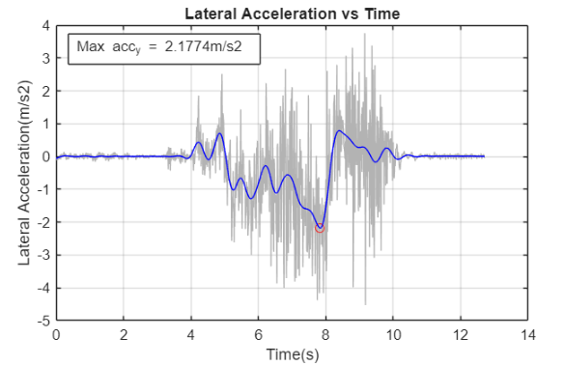
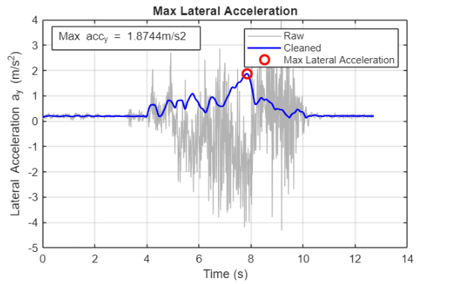
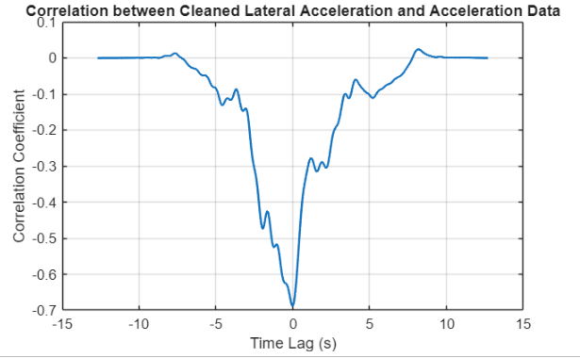
DAFTS PROJECT
20
LATERAL ACCELERATION
We have identified max Lateral Acceleration using the given Acceleration Y data.
The process involved-
Low Pass Filtering of the data after detrending to remove sensor bias
Moving RMS Window to suppress short duration spikes
Peak detection using the cleaned signal
Alternatively, we have also determined the lateral acceleration without considering the moving RMS window.
Fig. Filtered Acc Y Plot
Fig. RMS Corrected Acc Y Plot
Fig. Cross- Correlation
Politecnico di Milano | 1863 Arindam Sharma, Riddhima Srivastava

Slide 21
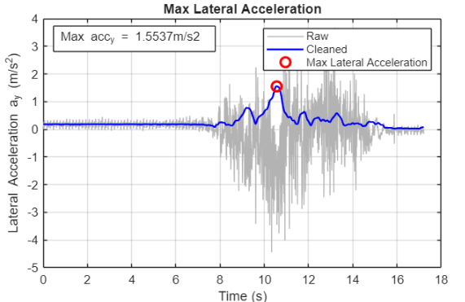
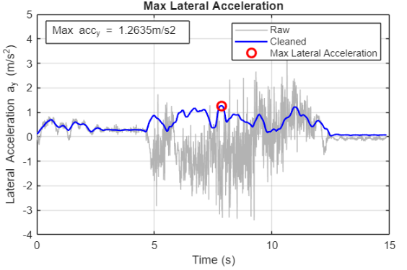
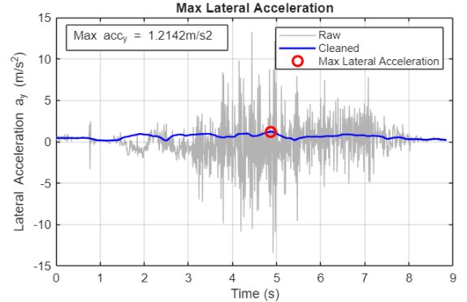
DAFTS PROJECT
21
LATERAL ACCELERATION
Fig. Data 1
Fig. Data 2
Fig. Data 3
Fig. Data 4
Politecnico di Milano | 1863 Arindam Sharma, Riddhima Srivastava

Slide 22
DAFTS PROJECT
22
LATERAL ACCELERATION
Table: Parameters considered for Moving RMS detection
Metric | Instantaneous Peak | Moving RMS Peak
Physical relevance | Represents a single-sample maximum, often influenced by noise or transients | Represents sustained lateral acceleration over a finite time window, aligned with tire and vehicle response
Noise sensitivity | Highly sensitive to sensor noise, spikes, and sampling artifacts | Low sensitivity due to time integration and energy averaging
Use in vehicle dynamics | Suitable for sensor validation or impact detection | Suitable for cornering performance, grip utilization, and handling analysis
Politecnico di Milano | 1863 Arindam Sharma, Riddhima Srivastava

Slide 23
Task 5 Gyroscope data correlation with Pitch and Roll
05

Slide 24
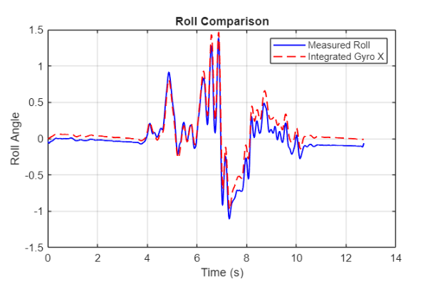
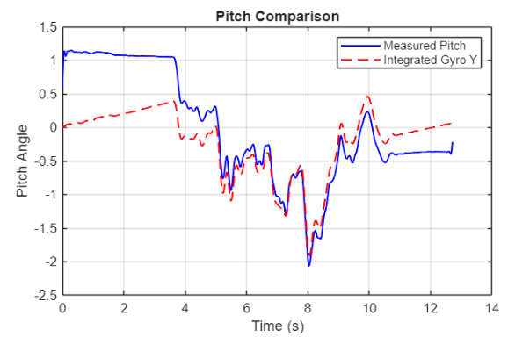
DAFTS PROJECT
24
GYROSCOPE DATA
We have utilized Gyroscope X and Y data which relate to pitch and roll.
Rotation about X axis = Roll
Rotation about Y-axis = Pitch
As mentioned in the task, we have integrated the data using the cumtrapz function in MATLAB.
Low- pass filtering and detrending has been carried out initially to filter out the gyro data noise.
At first glance, we can notice slight offsets in the data.
Fig. Roll Comparison
Fig. Pitch Comparison
Politecnico di Milano | 1863 Arindam Sharma, Riddhima Srivastava

Slide 25
DAFTS PROJECT
25
GYROSCOPE DATA
Aspect | Measured Roll / Pitch | Integrated Gyro | Effect on Plot
Physical meaning | Absolute orientation w.r.t. gravity | Relative angular change | Causes constant offset
Sensor source | Gyro + accelerometer (sensor fusion) | Gyroscope only | Different reference frames
Reference frame | Navigation / gravity frame | IMU body frame | Same shape, different level
Fig. Roll Comparison
Fig. Pitch Comparison
Politecnico di Milano | 1863 Arindam Sharma, Riddhima Srivastava

Slide 26
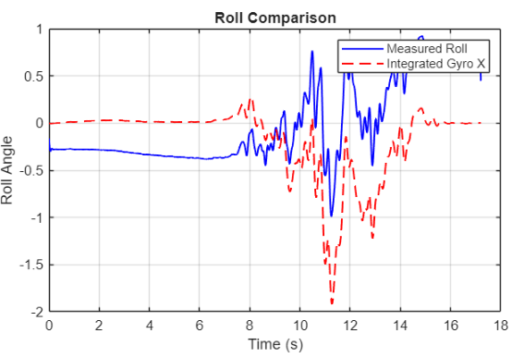
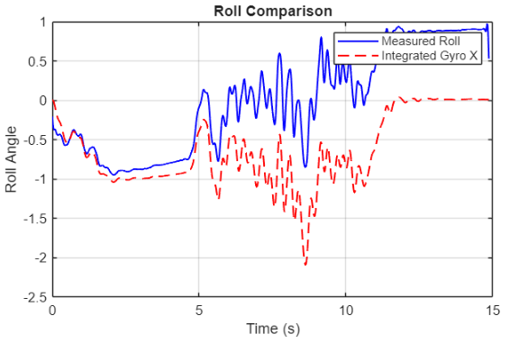
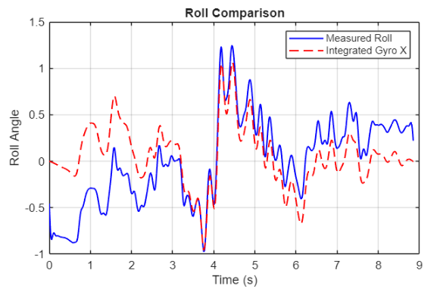
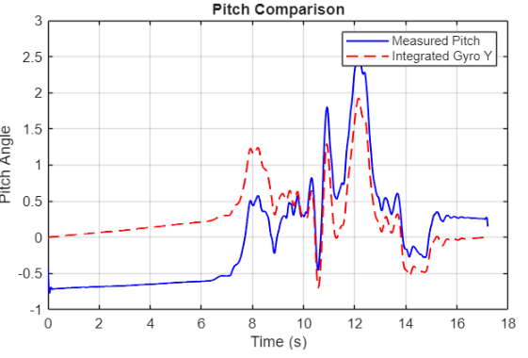
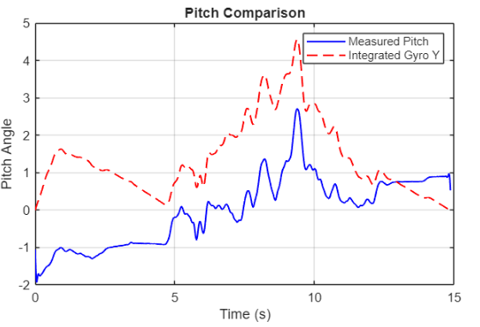
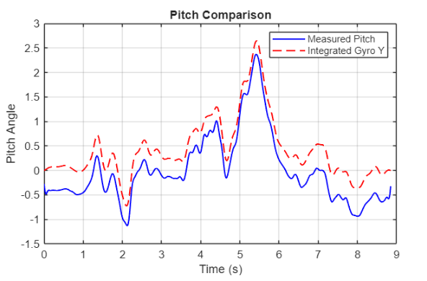
DAFTS PROJECT
26
DATA COMPARISON
Fig. Data 4
Fig. Data 3
Fig. Data 2
Fig. Data 1
Politecnico di Milano | 1863 Arindam Sharma, Riddhima Srivastava

Slide 27
Task 6 Spatial Lag
06

Slide 28
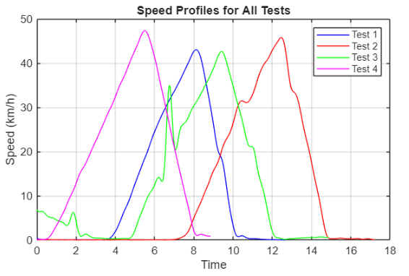
DAFTS PROJECT
28
SPATIAL LAG
To determine the spatial lag, we have utilized a second set of code independent of the individual dataset analysis.
We have implemented a function for speed calculation based on our earlier Haversine speed formulation.
Furthermore, by using a cumulative distance from speed calculation we have also defined a spatial domain.
Fig. Speed Profile of all Tests
Politecnico di Milano | 1863 Arindam Sharma, Riddhima Srivastava

Slide 29
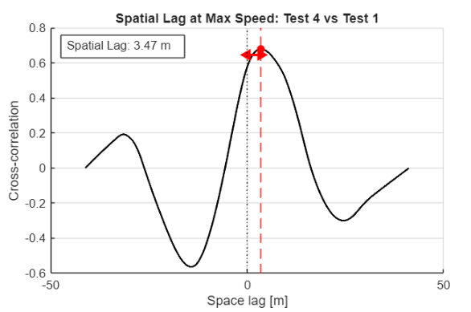
DAFTS PROJECT
29
SPATIAL LAG
The lag is determined as follows-
We have defined a window of around 150m around the max speed point to extract specific range of data.
Interpolated the test set spatial data against reference to have identical sampling size.
Cross-correlated the velocity data of two sets of data
Multiplying the measured lag to the mean distance of reference data.
Fig. Spatial Lag Detection
Politecnico di Milano | 1863 Arindam Sharma, Riddhima Srivastava

Slide 30
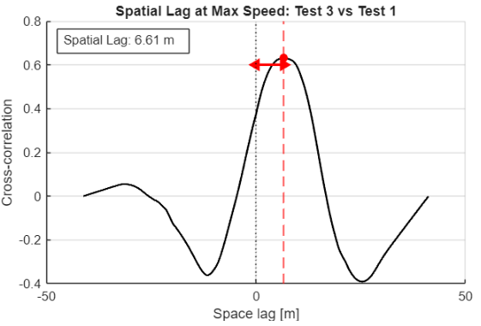
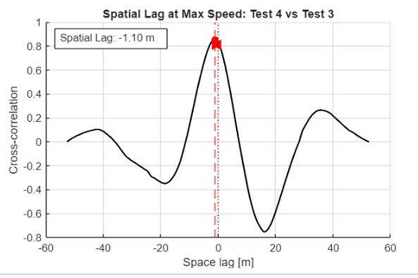
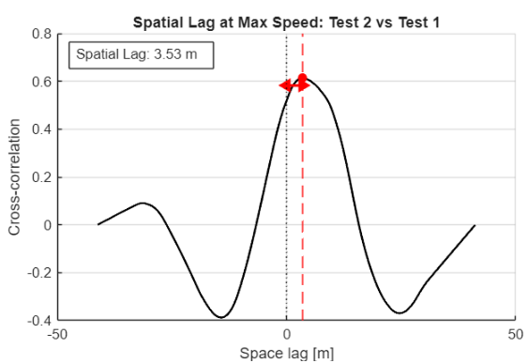
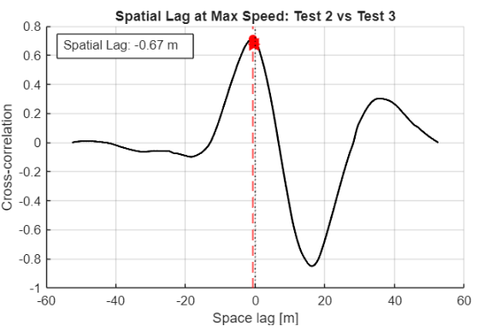
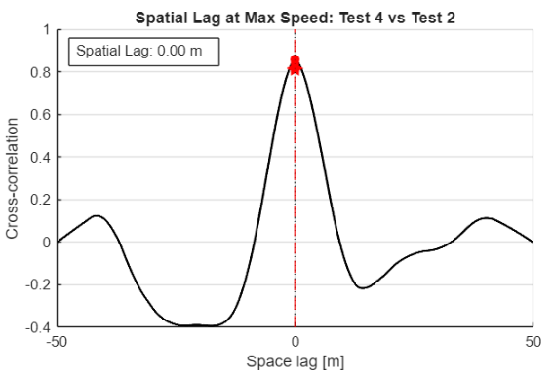
DAFTS PROJECT
30
SPATIAL LAG
Fig. Spatial Lags for All Datasets
Politecnico di Milano | 1863 Arindam Sharma, Riddhima Srivastava

Slide 31
Conclusions
07

Slide 32




DAFTS PROJECT
32
Marked Points on GPS Data
The following points have been marked-
Max Speed
Braking Onset
Steering Correction
Max Lateral Acceleration
Fig. Data 1
Fig. Data 2
Fig. Data 3
Fig. Data 4
Politecnico di Milano | 1863 Arindam Sharma, Riddhima Srivastava

Slide 33
DAFTS PROJECT
33
Conclusion
The Data Analysis Project has been carried out by us and has helped us better understand many of the concepts that were taught in class.
The work has been divided between the two of us with each handling one half of the task and developing an alternative method wherever possible.
We have taken multiple references from web sources, AI and class material for concept formulation and code implementation wherever possible.
The work split has been as follows –
Speed Profile (IMU) – Arindam
Speed Profile (GPS) – Riddhima
Braking Detection – Arindam
Steering Correction Analysis – Arindam
Lateral Acceleration – Riddhima
Gyro data and Roll/Pitch Correlation – Riddhima
Spatial Lag - Arindam / Riddhima
Presentation – Arindam / Riddhima
We thank the professors for their guidance and support.
Politecnico di Milano | 1863 Arindam Sharma, Riddhima Srivastava

